Slide 1

Keeping my family together
Mental health services
Presented by
Eric Murphy, Mental Health Specialist
Center for Excellence in Disabilities

Slide 2

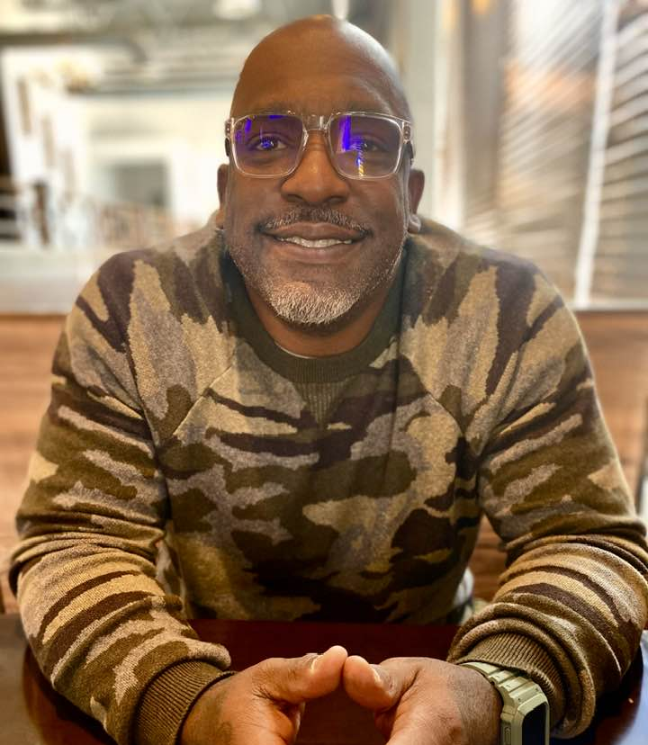
Who am I
Imagine you have a friend who is always feeling really sad or worried, and they don't know why.
I am is a skilled kind of person who can sit down with your friend, listen carefully to them, and then help them figure out why they are feeling that way. I can then teach your friend some new ways to feel better and deal with the problems they are facing.
Or let's say you're having a hard time making good choices, and you keep getting into trouble. I can work with you to understand why you're making those choices, and they can help you learn new ways of thinking and behaving that are healthier and better for you.
The most important thing to remember is I am here be like a really good other who wants to help you. That will listen to you without judging you and will support you towards understanding yourself and your feelings better. I am here to help you feel happier and healthier in your life.

Slide 3
Using Adlerian Theory
Defining the theory base

Slide 4

In a nut shell
Adlerian theory is a way of understanding family life that focuses on belonging, encouragement, and cooperation. It teaches that every person—child or adult—wants to feel valued and included, and that behavior is often a response to feeling either encouraged or discouraged. For families living with disability, Adlerian thinking helps shift the focus away from fixing or comparing and toward building dignity, connection, and shared responsibility. It reminds parents that a child is not their disability, that everyone contributes in their own way, and that mental well-being grows when families face challenges together with respect, compassion, and a strong sense of belonging

Slide 5

A Family Is a Community, Not a Performance
A family is not meant to be efficient, perfect, or impressive—it is meant to be cooperative.
For families with disabilities, harmony grows when:
Everyone belongs as they are, not as they “should be”
Success is measured by connection, not productivity
The home is a place where no one must constantly prove their worth
“Does our home feel like a place of belonging, or a place of pressure?”

Slide 6

Separate the Child from the Difficulty
“The child is never the problem—discouragement is.”
Disability can invite:
Overprotection
Frustration
Quiet resentment (often unspoken)
Encourage parents to:
Name the challenge without defining the child by it
Speak about difficulties as shared life tasks, not personal failures
Model compassion toward the situation, not irritation toward the child
This protects everyone’s emotional well-being.

Slide 7
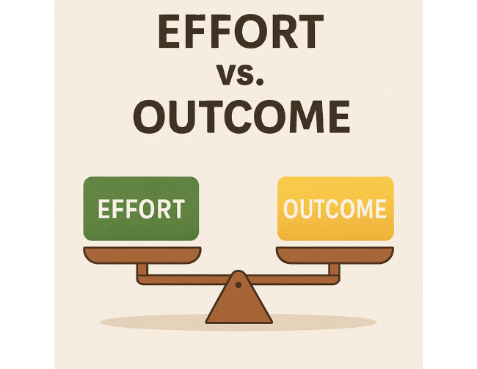
Encourage Effort, Not Outcomes
Adler warned against praise that compares or ranks.
In families with disabilities:
Progress may be uneven
Milestones may look different
Comparison silently destroys courage
Encouragement sounds like:
“I see how hard you tried”
“You stayed with it, even when it was frustrating”
“You belong here, even on hard days”
Encouragement builds mental resilience for the whole family.

Slide 8

Parents Must Care for Their Own Sense of Worth
parents unconsciously teach children how to feel about life.
Parents often carry:
Guilt (“Am I doing enough?”)
Shame (“Others seem to manage better”)
Exhaustion disguised as strength
Invite parents to reflect:
“Where do I feel discouraged?”
“Do I allow myself to be imperfect?”
A parent who practices self-acceptance teaches the family emotional safety.

Slide 9

Shift from Control to Cooperation
Adler believed control damages relationships—even when well-intended.
Disability often tempts parents to:
Over-manage
Decide everything “for safety”
Speak about children instead of with them
Harmony grows when families:
Invite participation at every possible level
Ask, “How can we do this together?”
Allow children dignity, not just protection
Mental health improves when everyone feels respected, not managed.

Slide 10

Normalize Struggle Without Making Life Heavy
Adler rejected the idea that suffering defines a person.
Encourage families to:
Speak honestly about hard days
Avoid making the home emotionally tense or fragile
Balance seriousness with play, humor, and ordinary joy
Children—disabled or not—need to know:
“Life can be difficult, and still worth engaging in.”
That belief strengthens family resilience.

Slide 11
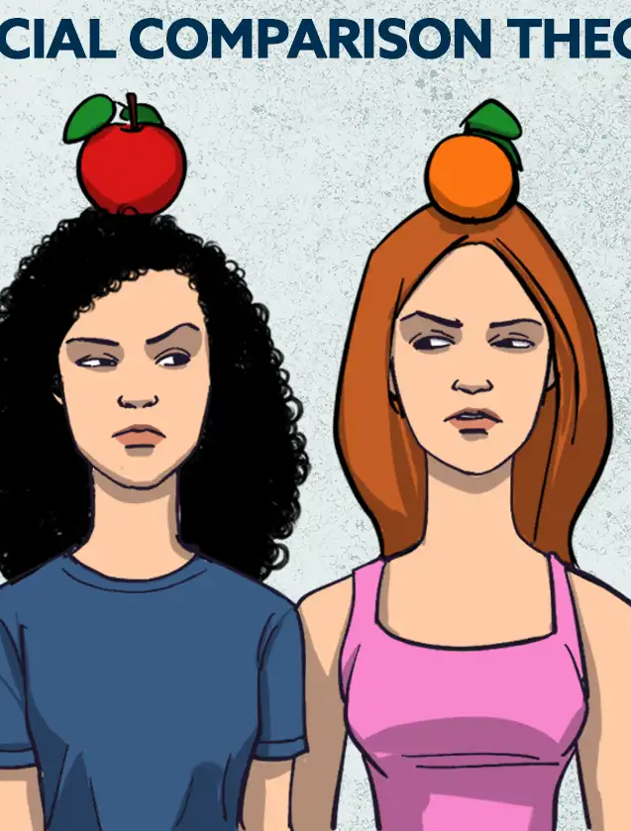
Reduce Comparison—Inside and Outside the Home
Adler warned that comparison creates inferiority.
Families with disabilities often compare:
Siblings to each other
Their family to others
Their present to an imagined “normal”
Encourage parents to practice:
Equality, not sameness
Respect for each child’s unique life task
Gratitude for what is, not grief for what isn’t
This keeps the emotional climate lighter and steadier.

Slide 12

Mental Health Is Practiced Daily, Not Fixed
Adler would say mental health is a way of relating, not a destination.
As a family:
Talk openly
Repair conflicts instead of avoiding them
Allow emotions without dramatizing them
Return again and again to cooperation
Harmony comes not from eliminating stress—but from meeting it together.

Slide 13

Benefits of Seeking Mental Health Support
  Improved self-awareness and personal growth
  Enhanced ability to navigate academic and life challenges
  Stronger relationships and family connections
  Increased resilience and overall wellbeing

Slide 14

Next Steps and Resources
How to schedule an initial consultation with Eric Murphy
contact information and scheduling details for the Center for Excellence in Disabilities

